Slide 1

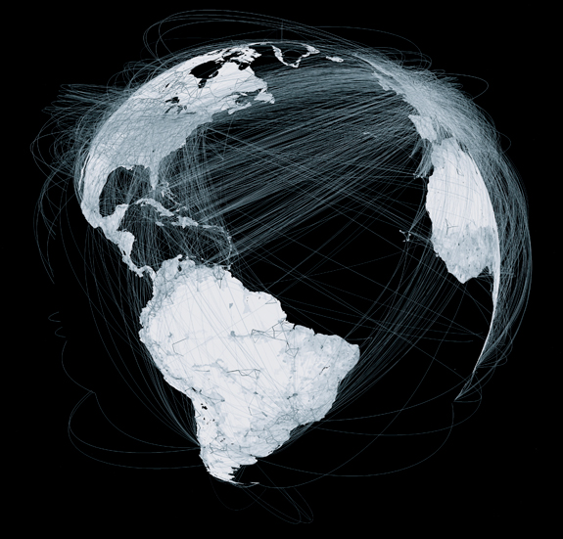
Demographics and Mobility
Laboratory for Communications and Applications
Khalil Hajji
Supervisor : Mohamed Kafsi
January 2015

Slide 2


Why Human Mobility ?
500 Million of tweets per day in the world
5 Millions Geo-tagged
Number in constant since 2009 (2.5M in 2009 500M in 2014)
75 Millions of Instagram photos per day
Most of them geo-localized

Slide 3
Why Human Mobility ?
Huge amount of data available
Big and Complex human mobility graph

Slide 4


Goal of our Work

Slide 5
Goal of our Work

Slide 6
Goal of our Work

Slide 7
Goal of our Work

Slide 8
Goal of our Work
Does our mobility exhibits some information about our person ?
Can we infer some characteristics about a person by looking only to his movements ?
Can we guess the ethnicity of a user based on the places he visited ?
Can we guess his age?
Can we guess his gender ?

Slide 9
Definitions
Check-in: The place visited by a person is called a check-in
Let be the set of the possible places where a user can do a check-in
Class: let be the set of the classes that could be assigned to a person
Ex: ,
Goal: guess the class of a person by observing his/her check-ins
Find a classification function:

Slide 10
Headlines
Latent Class Behavior (LCB)
Dataset
LCB results
Latent Personalized Behavior (LPB)
Results
Conclusion

Slide 11
Latent Class Behavior (LCB): Intuitions
The movements of each individual are unique, .i.e. cannot find two people that visited exactly the same places in the same order.
Question: Is there something in common in humans movements?
Intuition 1: Yes, people can have similar behaviors even if they don’t have exactly the same movements
Ex: Alice and Bob use to go to Times Square in their free time
Ex: Alice and Bob use to go to the financial district to work
Intuition 2 (Supposition): People belonging to same class have the same behaviors

Slide 12
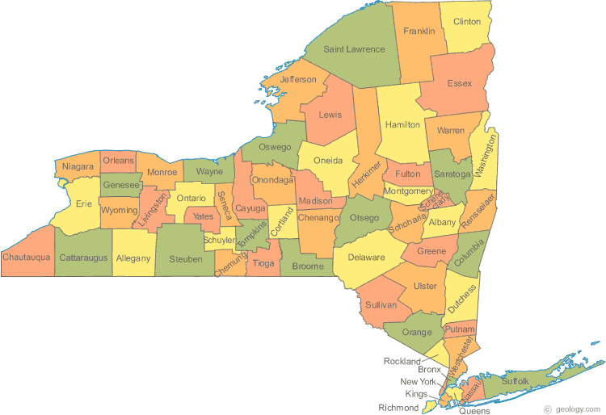
LCB: Model
Behavior 1
0.2
0.09
0.04
…
Behavior 2
0.1
0.08
0.04
…
Each class has distribution over behaviors
Each behavior is a distribution over places
Each check-in is drawn from a behavior

Slide 13
LCB: Generative model
chooses a class with probability
Behavior 1
0.2
0.09
0.04
…
Behavior 2
0.1
0.08
0.04
…

Slide 14
LCB: Generative model
chooses a class with probability
Behavior 1
0.2
0.09
0.04
…
Behavior 2
0.1
0.08
0.04
…

Slide 15
LCB: Generative model
Knowing his class, chooses a behavior with probability
Behavior 1
0.2
0.09
0.04
…
Behavior 2
0.1
0.08
0.04
…

Slide 16
LCB: Generative model
Knowing his class, chooses a behavior with probability
Behavior 1
0.2
0.09
0.04
…
Behavior 2
0.1
0.08
0.04
…

Slide 17
LCB: Generative model
Knowing his behavior, chooses a place with probability
Behavior 1
0.2
0.09
0.04
…
Behavior 2
0.1
0.08
0.04
…

Slide 18
LCB: Generative model
Knowing his behavior, chooses a place with probability
Behavior 1
0.2
0.09
0.04
…
Behavior 2
0.1
0.08
0.04
…

Slide 19
LCB: Generative model
choose a class with probability
Knowing the class, choose a behavior with probability
Knowing the behavior, choose a place with probability
To sample another place redo 2 and 3 (not 1)
Behavior 1
0.2
0.09
0.04
…
Likelihood:
Let be the check-ins of a user,
Behavior 2
0.1
0.08
0.04
…
Behavior 3
0.5
0.5

Slide 20
LCB: Learning parameters and classification
, are learn using the Expectation-Maximization (EM) algorithm
is directly inferred from data
Hyper-parameter that represents the number of behaviors is chosen manually by the user
Classification function: guessing the class of a person by observing it’s check-ins

Slide 21
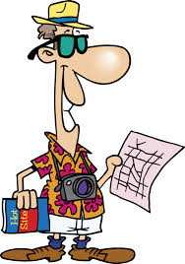


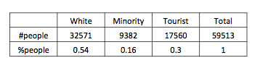
Dataset of geo-tagged tweets in New York
~ 60000 persons
~ 1 Million geo-tagged tweets in New York
Classes :
Unbalanced data

Slide 22
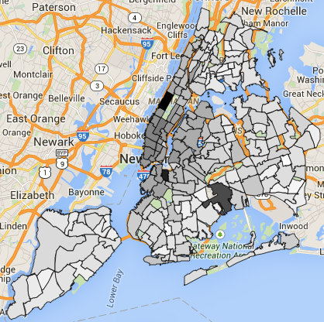
Dataset of geo-tagged tweets in New York
Check-ins: Each tweet is a check-in
Check-ins aggregated by neighborhood: sparcity
Number of Tweets in New York by neighborhood. The darker the color, the more tweets there is.

Slide 23
Results: metrics

Slide 24
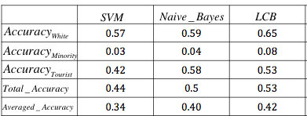
Results: comparing to Naïve Bayes & SVM
LCB performs much better than SVM (8% better)
LCB does 2% better than Naïve Bayes
LCB makes the data much more predictable that Naïve Bayes

Slide 25
Latent Personalized Behavior (LPB): Intuitions
In LCB, a behavior is a distribution over places
Intuition 1: A behavior could also be; how much someone goes to places he already visited.
Ex: Alice often goes to places she already visited
Ex: Bob wants to discover new places
Intuition 2 (Supposition): People belonging to same class have same probability to have this behavior
i.e. if Alice & Bob belong to the same class, then they will have the same probability to go to places they already visited.

Slide 26
LPB: Model (1)
How can we represent such a behavior ?
Idea: keep LCB and extend it
Add one behavior to the already existing behaviors
is common to people of same class and need to be learned with the other parameters
represents probability to do check-in in when the sampling will be done from the already visited places. Unique for each user.

Slide 27
LPB: Model (2)
Behavior 1
0.2
0.09
0.04
…
Behavior 2
0.1
0.08
0.04
…
Behavior 3
One behavior added (pink)
are common to each class
are unique for each user and are empty at the initial state

Slide 28
LPB: Generative model
Let a user be at the initial state
chooses a class with probability
Behavior 1
0.2
0.09
0.04
…
Behavior 2
0.1
0.08
0.04
…
Behavior 3

Slide 29
LPB: Generative model
Let a user be at the initial state
chooses a class with probability
Behavior 1
0.2
0.09
0.04
…
Behavior 2
0.1
0.08
0.04
…
Behavior 3

Slide 30
LPB: Generative model
Knowing his class, chooses a behavior with probability
Behavior 1
0.2
0.09
0.04
…
Behavior 2
0.1
0.08
0.04
…
Behavior 3

Slide 31
LPB: Generative model
Knowing his class, chooses a behavior with probability
Behavior 1
0.2
0.09
0.04
…
Behavior 2
0.1
0.08
0.04
…
Behavior 3

Slide 32
LPB: Generative model
Knowing his behavior, chooses a place with probability
Behavior 1
0.2
0.09
0.04
…
Behavior 2
0.1
0.08
0.04
…
Behavior 3

Slide 33
LPB: Generative model
Knowing his behavior, chooses a place with probability
Behavior 1
0.2
0.09
0.04
…
Behavior 2
0.1
0.08
0.04
…
Behavior 3
1

Slide 34
LPB: Generative model
Knowing his class, chooses another behavior with probability
Behavior 1
0.2
0.09
0.04
…
Behavior 2
0.1
0.08
0.04
…
Behavior 3
1
Behavior 3

Slide 35
LPB: Generative model
Knowing his class, chooses another behavior with probability
Behavior 1
0.2
0.09
0.04
…
Behavior 2
0.1
0.08
0.04
…
Behavior 3
1
Behavior 3
Behavior 3

Slide 36
LPB: Generative model
Knowing his behavior, chooses another place with probability
Behavior 1
0.2
0.09
0.04
…
Behavior 2
0.1
0.08
0.04
…
Behavior 3
1
Behavior 3
Behavior 3

Slide 37
LPB: Generative model
Knowing his behavior, chooses another place with probability
Behavior 1
0.2
0.09
0.04
…
Behavior 2
0.1
0.08
0.04
…
Behavior 3
0.5
0.5

Slide 38
LPB: Generative model
choose a class with probability
Knowing the class, choose a behavior with probability
Knowing the behavior, choose a place with probability
Update
Behavior 1
0.2
0.09
0.04
…
Likelihood:
Let be the check-ins of a user,
Behavior 2
0.1
0.08
0.04
…
Behavior 3
0.5
0.5

Slide 39
LPB: Learning parameters and classification
, are learn using the Expectation-Maximization (EM) algorithm
Exception: is not learnt!
is directly inferred from data
Hyper-parameter chosen manually by the user
Classification function: guessing the class of a person by observing it’s check-ins

Slide 40
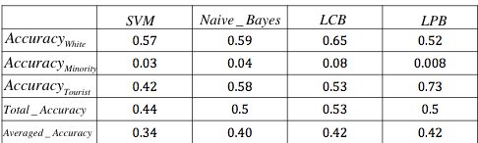
LPB Results: comparing to other classifiers
LPB performs as well as LCB (in )
LPB guesses much more Tourists than LCB, but less Minority
LPB makes the data more predictable than LCB

Slide 41
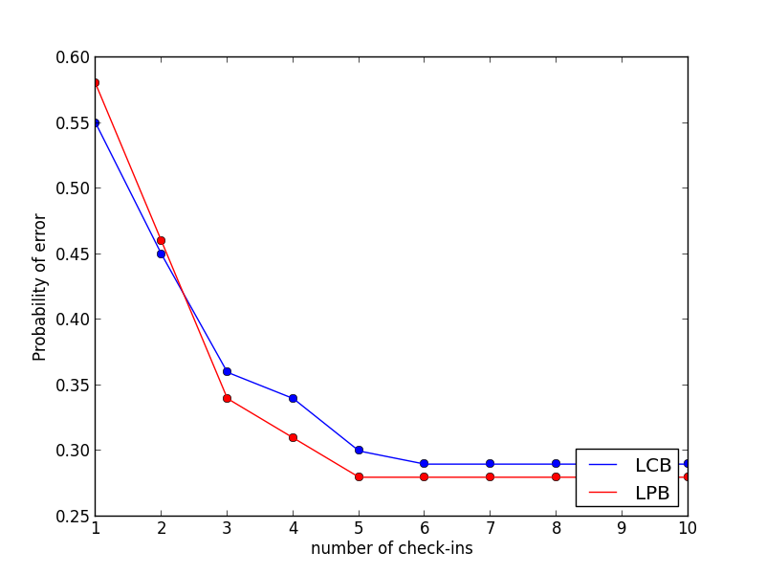
Results(1): LPB & LCB
Exponential of error with of the number of samples
Need only 5 samples to make guesses

Slide 42
Results(2): LPB & LCB
Probability of error is around 0.3 starting from 5 samples very low
LCB better for few samples / LPB better for more samples

Slide 43
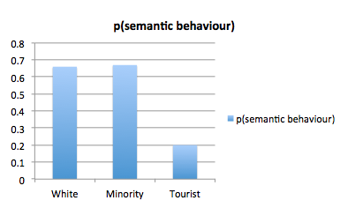

Results: Probability of added behavior LPB

Slide 44
Results: Probability of added behavior LPB
In fact tourists tend to discover more new places than locals

Slide 45
Conclusion: LPB vs LCB
LPB
LCB
Makes the data more predictable
Better for big number of samples per user (> 2 samples/person)
Is well designed for Local vs Tourist separation
Gives a description of the data ( parameter)
Better if goal is to make the maximum number of correct guesses
Better for a very sparse data (<= 2 samples/person)
Better to guess minorities

Slide 46
Conclusion
The proposed models both do much better than the baselines Naive_Bayes and SVM
Able to guess the class of a person based on his mobility with some certainty (0.5 of chance to be right in the worst case)
We do not need more that 5 visited places to be able to make the best possible guess
The mobility of a person is sufficient to give informations about his characteristics
Our mobility is influenced by our social characteristics

Slide 47

Questions

